Slide 1


Hardware Prefetcher Aggressiveness Controllers: Do We Need Them All the Time?
Anuj Mishra, bandan Panda
Indian Institute of Technology Kanpur
Biswa
NOPE @ ASPLOS April 2021
Notes:
GM everyone, my name is Anuj mishra, I am a masters students at IITK, if you’re not able to see me clearly this is me :) Inspired by the earlier talks, I’ll be sharing my work in a form of a short story. Apart from me, the important character here is Biswa.

Slide 2
Hardware Prefetching: 101
Notes:
Let’s start by first quickly understanding basics of prefetching

Slide 3
Hardware Prefetching: 101
CORE 0
Access pattern
A
A | A+2 | A+4 | A+6 | A+8 | A+10
A+8
MISS
MISS
MISS
MISS
HIT
HIT
PREFETCHER
CACHE
A+8
DRAM
X
Demand request for X
X
Prefetch request for X
Notes:
Here we have a processor core, fast on-chip cache, slow off chip dram and our start element prefetcher which sits beside cache and is able to see all the requests that go into the cache.
Assuming the application is going to access some array whose elements are placed at A, A+2, A+4 ...
When requests for A goest to cache it gets a miss and data is brought from DRAM into cache and then to core, since cache was initially empty, next access will also get miss in cache, Now since the prefetcher is able to see the requests, it observes the pattern of +2 being repeated, so it creates a prefetch rquests for next element A+8 and brings data into cache.
Now when the processor creates a request for A+8 it will get a hit and response is sent quickly to core. As long as this pattern is being repeated, we’ll get cache hits.
So the goal of prefetching is to improve performance by converting cache miss to hits.

Slide 4
It’s Not That Simple
Many applications have hard to predict access patterns

Slide 5
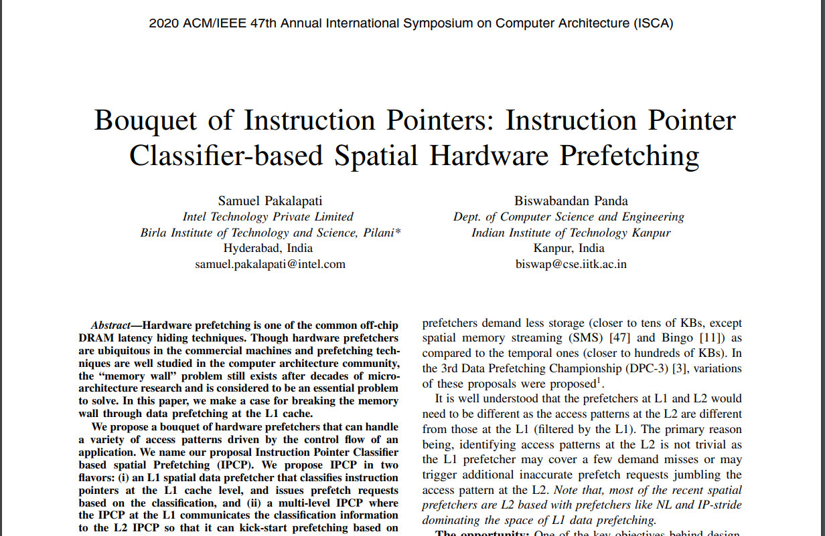
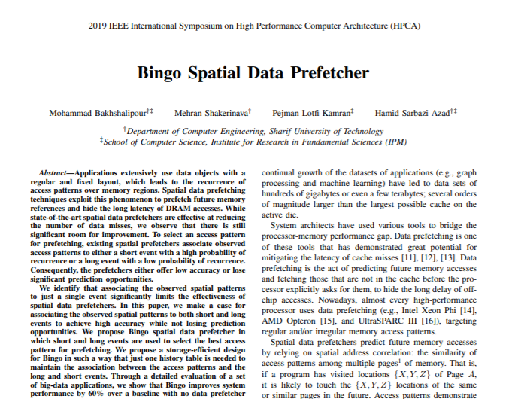
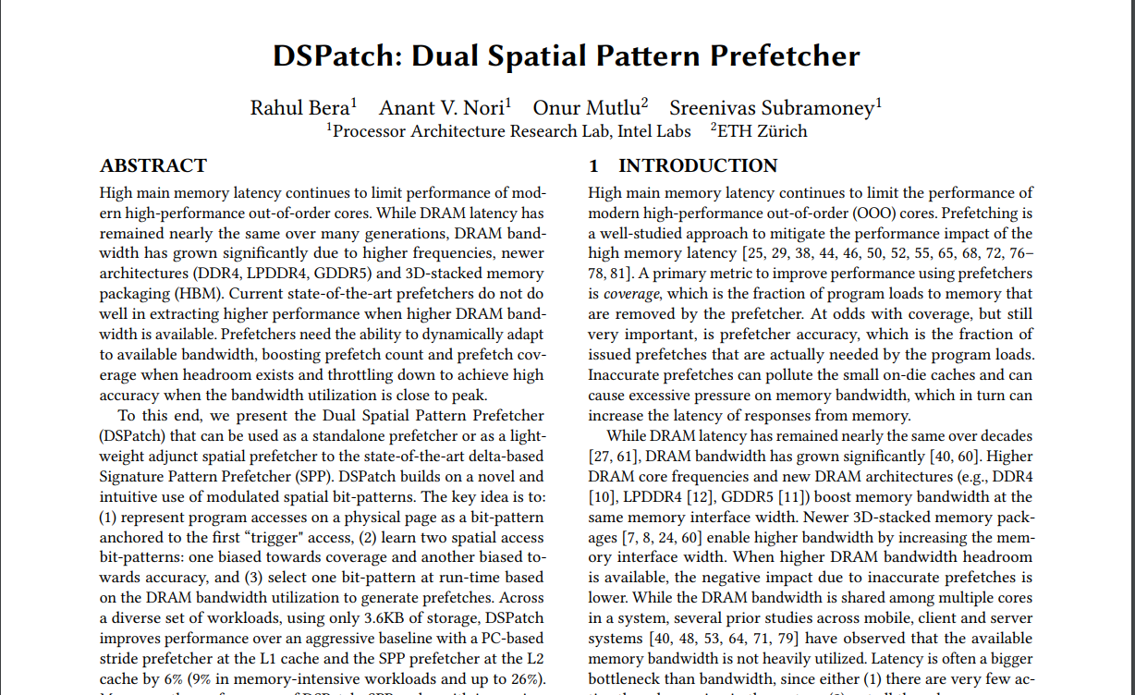
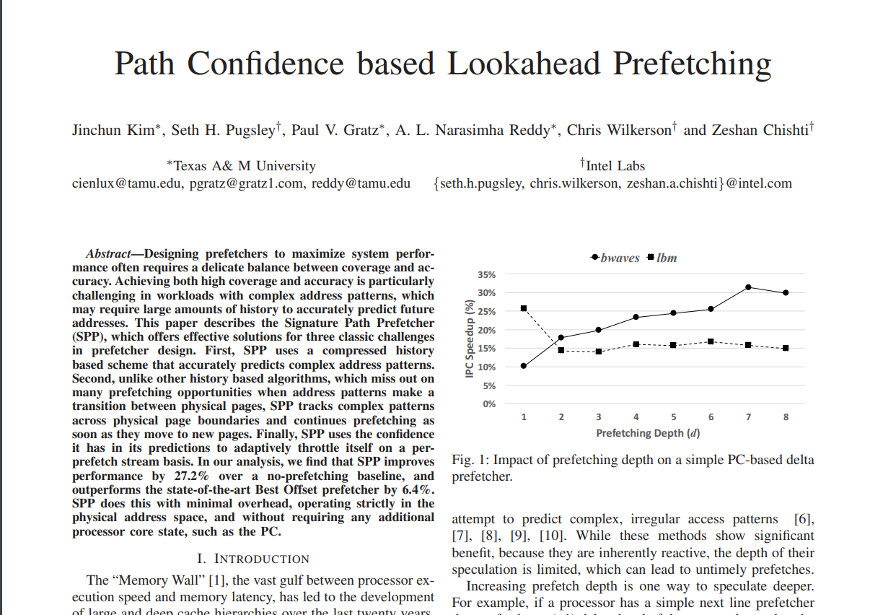

So Many Prefetchers...
Notes:
After understanding basics, I went on to read more about diffrerent prefetchers,
I came to know that every year or so we get a new hardware prefetcher which is able to convert more and more cache misses to hits.
To do so, apart from their ability to predict more patterns, these prefetchers perform aggressive prefetching

Slide 6


Aggressive Prefetching
Increase prefetch degree
Increase prefetch distance
A+8
A+8
A+10
A+12
A+8
A+14
A+16
*Images are taken from internet and are modified for the purpose of this presentation
Notes:
What I mean by aggressive prefetching is:
1) they issue multiple prefetch requests,
for instance instead of issuing a single request for A+8, they issue requests for A+8, A+10 and so on
here the prefetch degree is 3
2) Just like a sniper, they increase prefetch distance and look farther into the access stream
i.e, instead of issuing requests for just the next element they’ll issue requests for A+14, 16, which will be demanded much later by porocessor

Slide 7
What can I do?
Prefetching has issues in many-core systems
Notes:
Now after having clear understanding about prefetching and dealing with covid, I had a discussion with biswa and he told me to look into many core systems, prefetching has many issues there

Slide 8
Prefetching in Single-core
CORE 0
Access pattern
A
A | A+2 | A+4 | A+6 | A+8 | A+10
A+8
MISS
MISS
MISS
MISS
HIT
HIT
PREFETCHER
CACHE
A+8
DRAM
X
Demand request for X
X
Prefetch request for X
Notes:
After having fully understood the prefetching

Slide 9

Prefetching in Many-core
CORE 0
CORE 1
CORE 2
CORE N-1
DRAM bandwidth congestion late prefetches prefetching becomes useless
...
A+8
CACHE
CACHE
CACHE
CACHE
...
A+8
H
C
D
I
X
Demand request for X
DRAM
X
Prefetch request for X
Notes:
Let’s understand one of the main issue using same example as earlier,(prefethcers are not shown for clarity)
the prefetcher predicted that A+8 will be accessed, and issued prefetch requests for that, but since all cores share DRAM bandwidth, the request is waiting for its chance,
Now while other requests were being serviced, the demand for A+8 arrived at cache, it got a miss and waits for data.
when A+8 gets a chance it goes to dram and response is finally sent back to core.
Now, as you have observed, because DRAM BW was congested, prefetch request got late and demand got a miss inspite of prefetching. so there was no uitility of prefetching
we cannot stop a core from demanding data, but we can try to reduce the prefetch requests.

Slide 10
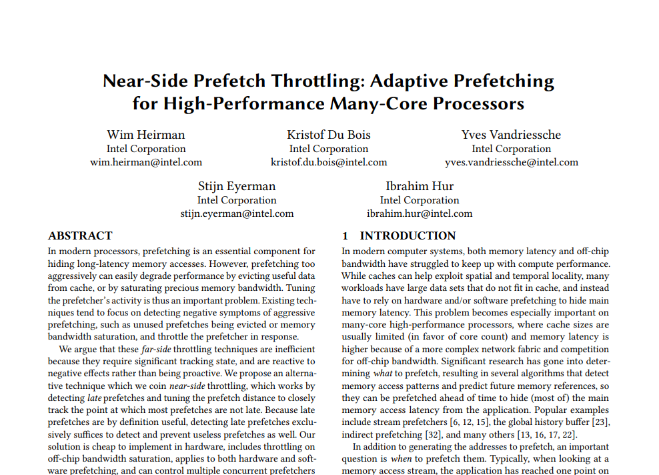
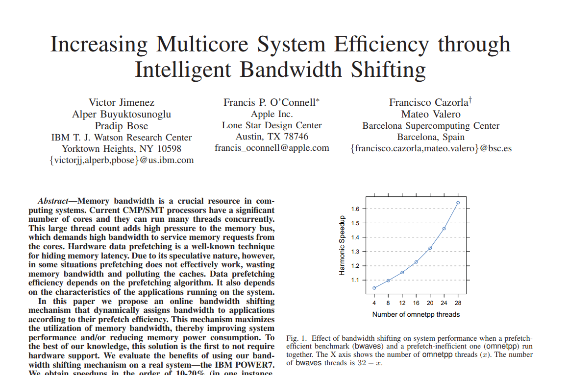
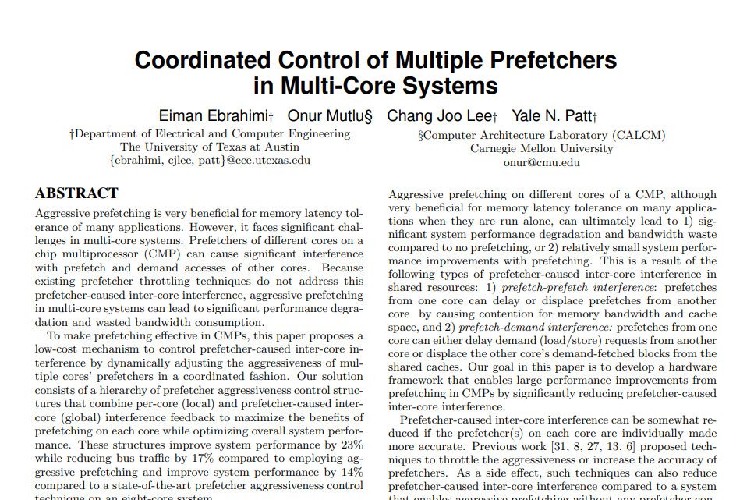
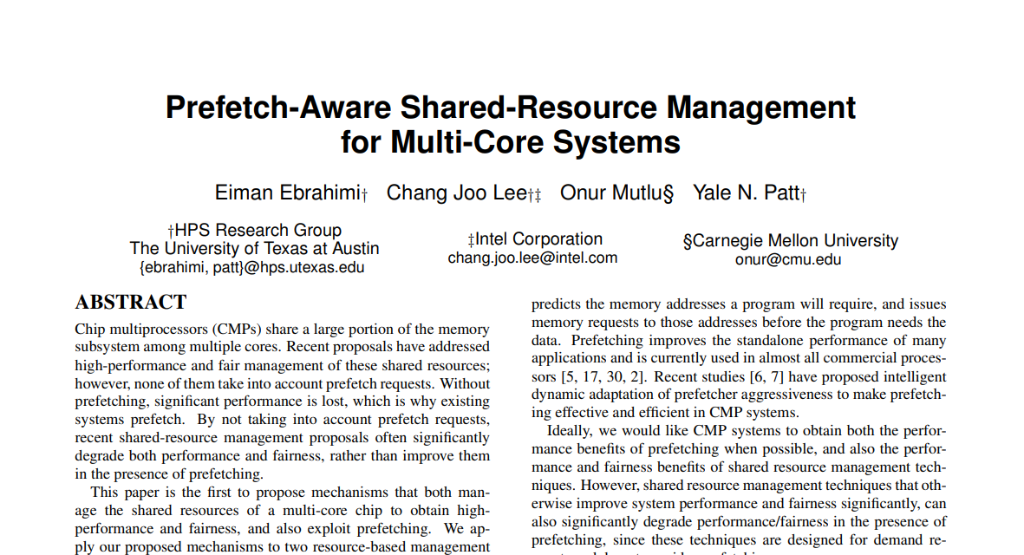
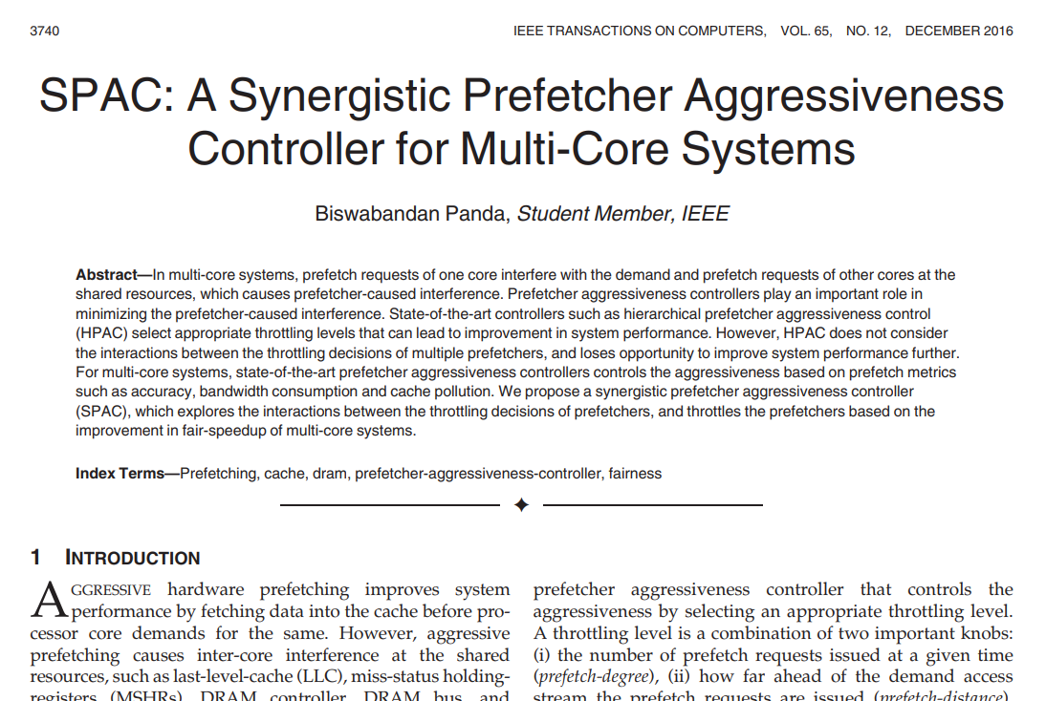
Prefetch Aggressiveness Controllers
Notes:
There are so many works which try to do this exactly.
They propose modifying existing hardware, add new components and look at various metrics like prefetch accuracy, cache pollution, effect of prefetching of one core on other etc etc,
Being interested in these techniques I started coding them, While doing so I noticed that all though these mechanism seem different in impementation, but the core idea behind them is common.

Slide 11


Prior Works
CORE 0
CORE 1
CORE 2
CORE N-1
...
CACHE
CACHE
CACHE
CACHE
...
Observe application behavior
and create clusters of:
(a) Prefetch friendly app.
(b) Prefetch unfriendly app.
DRAM
*Images are taken from internet and are modified for the purpose of this presentation
Notes:
All the mechanism in prior work, observe the application running on core, and create cluster of application which are pref. friendly (here, green cluster) that get more benefit with prefetching compared to unfriendly(here, red cluster)
They try to reduce DRAM traffic by not allowing red cluster to issue any prefetch requests

Slide 12

Thanks for your time
What if you don’t have such diversity?
CORE 0
CORE 1
CORE 2
CORE N-1
...
CACHE
CACHE
CACHE
CACHE
Wait a minute...
...
DRAM
*Images are taken from internet and are modified for the purpose of this presentation
Notes:
Now these mechanism work well and nothing new is needed,
before someone actually stops me from presenting and you all leave for your cofee, wait a minute

Slide 13

Homogeneous Workloads
CORE 0
CORE 1
CORE 2
CORE N-1
...
CACHE
CACHE
CACHE
CACHE
Prefetch friendly application
Prefetch unfriendly application
...
DRAM
Notes:
For instance, the applications running on server are generally multi-threaded and homogeneous in nature, and thus they have similar prefetch behavior
all friendly or all unfriendly

Slide 14
Homogeneous Workloads
CORE 0
CORE 1
CORE 2
CORE N-1
...
CACHE
CACHE
CACHE
CACHE
Prefetch friendly application
Prefetch unfriendly application
...
DRAM
Notes:
Since we cannot stop any particular core from issuing prefeth request, we divide the prefetch access over time to understand the utility of prior works.

Slide 15
Clustering on Homogeneous Workloads
Time
Application execution time
q
CS=1
C0
C1
C2
C3
C0
C1
C2
C3
Pref-ON
Pref-OFF
CS=2
C0,C1
C2,C3
C0,C1
C2,C3
C0,C1
C2,C3
C0,C1
C2,C3
Pref-ON
Pref-OFF
CS=4
C0,C1,C2,C3
Pref-ON
*q --> Time Quantum; CS-->Cluster Size
Notes:
Let’s understand what I mean by that through a simple example
Cluster size means how many cores will be allowed to issue prefetch requests.
Let’s assume we have a 4 core system, with cluster size 1 each core is in one cluster, and only the cluster which is selected/scheduled can issue prefetch requests during its turn.
cluster size 1 has 4 clusters, thus any cluster is able to issue requests for 1/4th of the time
with cs=2, 50% and so on

Slide 16
Clustering on Homogeneous Workloads
Time
Application execution time
q
CS=1
C0
C1
C2
C3
C0
C1
C2
C3
Pref-ON
Pref-OFF
CS=2
C0,C1
C2,C3
C0,C1
C2,C3
C0,C1
C2,C3
C0,C1
C2,C3
Pref-ON
Pref-OFF
Pref-ON
CS=3
C0,C1C2
C3,C0,C1
C2,C3,C0
C1,C2,C3
C0,C1C2
C3,C0,C1
C2,C3,C0
C1,C2,C3
Pref-OFF
*q --> Time Quantum; CS-->Cluster Size
Notes:
Let’s understand what I mean by that through a simple example
Cluster size means how many cores will be allowed to issue prefetch requests.
Let’s assume we have a 4 core system, with cluster size 1 each core is in one cluster, and only the cluster which is selected/scheduled can issue prefetch requests during its turn.
cluster size 1 has 4 clusters, thus any cluster is able to issue requests for 1/4th of the time
with cs=2, 50% and so on

Slide 17
Redesigning prior works
To reduce DRAM bandwidth congestion, allow few cores to issue prefetch requests at a time.
All prefetchers on all the time + High congestion
Few core’s prefetcher on at a time + Low congestion
VS

Slide 18
Prefetching in Many core
DRAM bandwidth congestion late prefetches prefetching becomes useless
Notes:
The problem of prefetching in many core was late prefetches
let’s see whether we were to do something or not

Slide 19
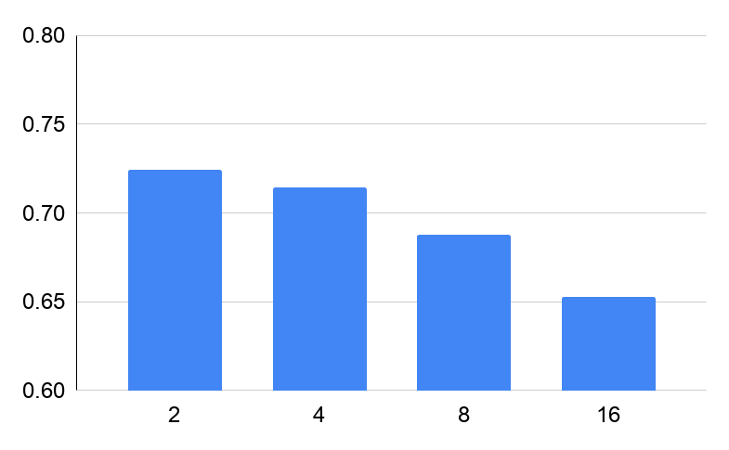
Prefetch Timeliness
gcc : 16 core
Prefetch requests are timely compared to baseline (All prefetchers on all the time)
Timeliness (IPCP-L1D)
(Higher the better)
Baseline
Cluster size
Notes:
Timeliness is the fraction of requests which are not late
Since the results are for 16 core system, cluster size 16 means only 1 cluster with all prefetch requests
As we can see, clustering is able to reduce number of late requests.
Let’s see the effect on performance

Slide 20
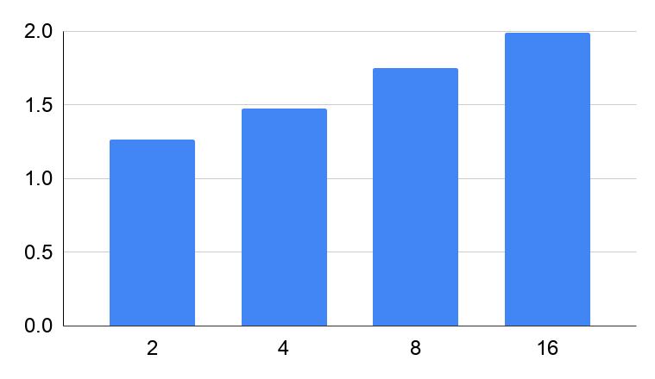
Performance
gcc : 16 core
Baseline
Clustering can cause performance degradation
Performance normalized
w.r.t. no prefetching
Cluster size
Notes:
Here we see that performnace is actually better in baseline
but we improved timeliness, so perfromance should have been improved

Slide 21

Why is Performance Not Improving?
Application execution time
Pref-ON
Pref-OFF
*Images are taken from internet and are modified for the purpose of this presentation
Notes:
The reason why perfromance is not improving is this:
The small improvemnet we made by making prefetch requests timely is crushed by the degradation we get because we didn’t allow the prefetching for complete time

Slide 22
What did We Learn?
Clustering mechanisms don’t work in multi-threaded, homogeneous workloads.
What about prefetch unfriendly applications?
Notes:
What should we do, simply enable prefetching?
but there are applications which don’t get benefit from prefetching

Slide 23
Naive Profiler
Training phase
EXECUTION PHASE
In training phase, profiler decides whether to keep all prefetchers ON or OFF for the upcoming execution phase
Notes:
So we propose a naive performance based profiler which has a small training phase in which it determines the utility of prefetching
It disables prefetcher if there is no benefit of prefetching

Slide 24
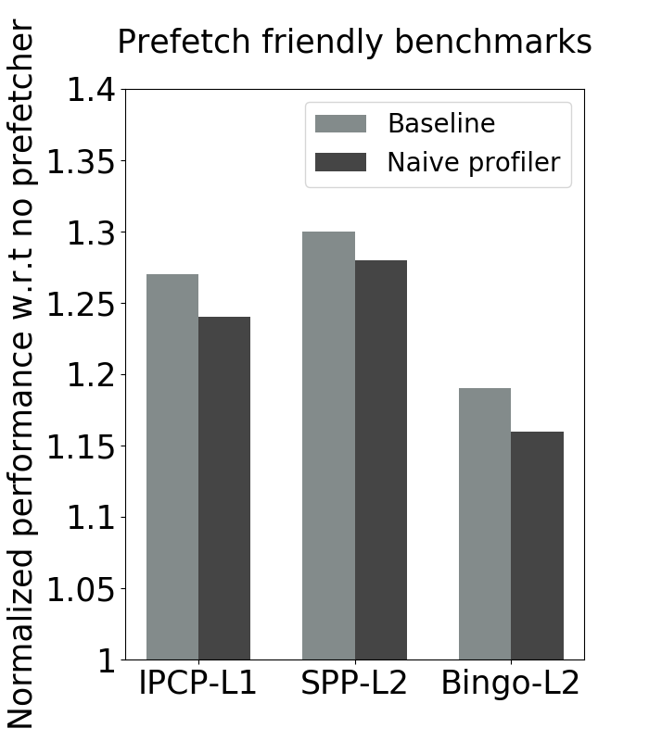
Naive Profiler Results
Performance normalized w.r.t. no prefetcher
Prefetch friendly applications
Notes:
We show the results of profiler with different SOTA prefetchers
For prefetch friendly app, profiler perform similar to baseline

Slide 25
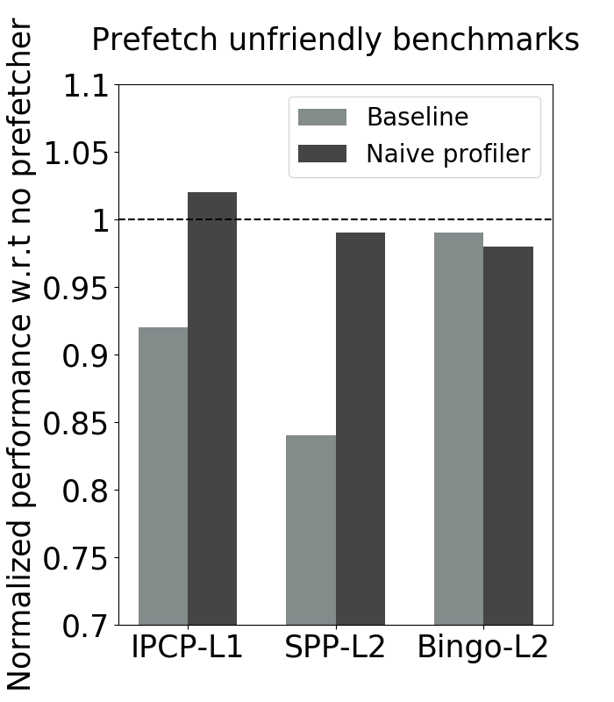
Naive Profiler Results
Performance normalized w.r.t. no prefetcher
Prefetch unfriendly applications
Notes:
for unfriendly, the profiler detects that prefetching can hurt performance and disables it.

Slide 26

Hardware Prefetcher Aggressiveness Controllers: Do We Need Them All the Time?
Thanks to Intel and SRC for funding our research
Notes:
coming back to our orignal question
do we need prefetch aggressive controllers,
no there is no need for any complex mechanisms, a simple profiler implemented in software is enough to get maximum benefit from prefetching

Slide 27
Thanks for your time
Questions?

Slide 28
DRAM Bandwidth problem

Slide 29
Acknowlegements
Images are taken from internet and are modified for the purpose of this presentation

Slide 30
OUTLINE(TEMP)
Emphasize motivation, impact -
Prefetching introduction
Prefetching improvement in multicore: low vs high BW
Body
Prior works: and why we don’t need them for servers
General classification and grouping/clustering
Clustering results(performance only or timeliness too?)
Naive profiler
Conclusion

Slide 31
Prefetching
CORE
t1
x;x+2;x+4
t5
x+6
PREFETCHER
x+6
CACHE
t2
t3
t4
x+6
x+6
DRAM

Slide 32

Prefetching
CORE 0
A
Demand request for X
X
L2C
HIT
X
Prefetch request for X
A
DRAM

Slide 33
Prior works
Create group/cluster of cores with similar prefetch behavior
Reduce extra DRAM traffic of prefetching by turning off prefetcher for prefetch unfriendly applications

Slide 34
Redesigning prior works
To reduce DRAM bandwidth congestion, allow few cores to issue prefetch requests at a time.
We examine the performance tradeoff between:
Having all prefetcher on (high bandwidth congestion)
Having few(=cluster size) core’s prefetcher on at a time (low bandwidth congestion)

Slide 35
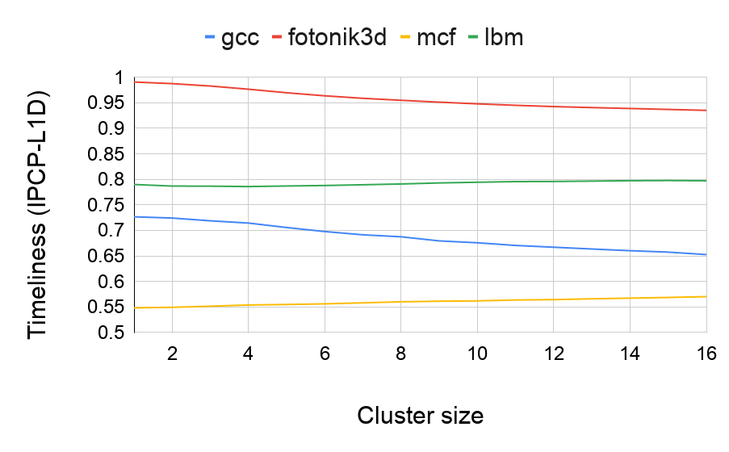
Prefetch timeliness is improving
Results are for 16 core system so, cluster size = 16 is same as having all core’s prefetcher on
Prefetch friendly
application
Prefetch unfriendly application

Slide 36
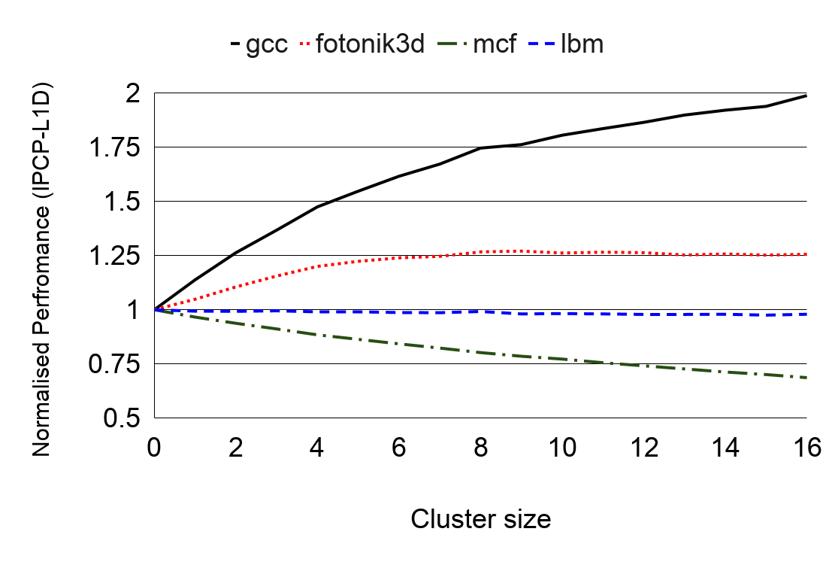
But not performance
Results are for 16 core system so, cluster size = 16 is same as having all core’s prefetcher on
Prefetch friendly
application
Prefetch unfriendly application

